Slide 1
Object Detection

Slide 2
Mean Average Precision (mAP) [1]
True Positive (TP): A correct detection. Detection with IOU ≥ threshold

Slide 3
Mean Average Precision (mAP) [1]
True Positive (TP): A correct detection. Detection with IOU ≥ threshold
False Positive (FP): A wrong detection. Detection with IOU < threshold

Slide 4
Mean Average Precision (mAP) [1]
True Positive (TP): A correct detection. Detection with IOU ≥ threshold
False Positive (FP): A wrong detection. Detection with IOU < threshold
False Negative (FN): A ground truth not detected

Slide 5
Mean Average Precision (mAP) [1]
Let us say that the model has detected some bounding box and labelled that as “person”. We need to compare the detected bounding box with all ground truth bounding boxes of person. If the IoU between the detected bounding box and any ground truth bounding box of person is >= threshold, we say that the detection is TP

Slide 6


Mean Average Precision (mAP) [1]
Precision and Recall:

Slide 7
Mean Average Precision (mAP) [1]
Also, please remember, we calculate these (TP, FP and FN as well as Precision and Recall) for each of the classes separately.

Slide 8
Mean Average Precision (mAP) [1]
Also, please remember, we calculate these (TP, FP and FN as well as Precision and Recall) for each of the classes separately.
We need to calculate precision @ each of the recall. We average precision over all these recall and therefore we say that it is average precision (AP). We need to calculate AP for each class and IoU combinations. mAP is AP averaged over all possible classes and IoU combinations. Remember that TP depends on IoU threshold. We need to sort predictions as if we are to calculate P @0.2 recall, we should use the predictions which are the most confident ones.

Slide 9
Mean Average Precision (mAP) [1]
Precision and Recall:
Average Precision
mean Average Precision

Slide 10
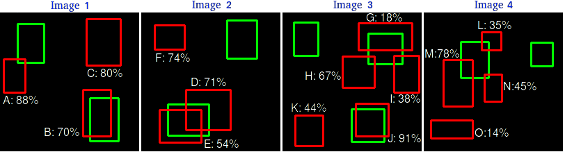
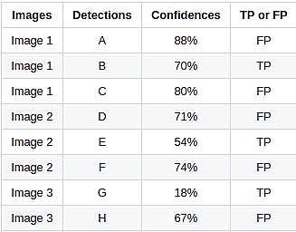
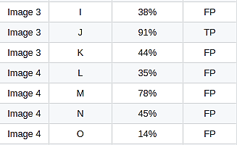
Mean Average Precision (mAP) [1]
TP or FP: (Note: Images with the detection and the ground truth of one specific class)

Slide 11
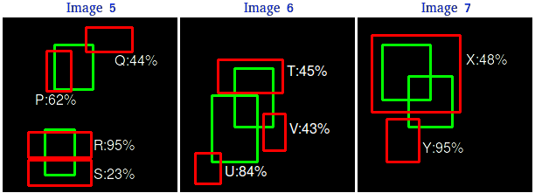
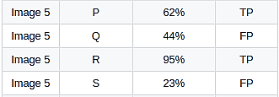
Mean Average Precision (mAP) [1]
Precision and Recall:

Slide 12
Mean Average Precision (mAP) [1]
Precision and Recall:
There are 7 images with 15 ground truth objects represented by the green bounding boxes and 24 detected objects represented by the red bounding boxes. Each detected object has a confidence level and is identified by a letter (A,B,...,Y).
The table shows the bounding boxes with their corresponding confidences. The last column identifies the detections as TP or FP. In this example, a TP is considered if IOU 30%, otherwise it is a FP. By looking at the images above we can roughly tell if the detections are TP or FP.
In some images there are more than one detection overlapping a ground truth (Images 2, 3, 4, 5, 6 and 7). For those cases the detection with the highest IOU is taken, discarding the other detections.
The Precision x Recall curve is plotted by calculating the precision and recall values of the accumulated TP or FP detections. For this, first we need to order the detections by their confidences, then we calculate the precision and recall for each accumulated detection as shown in the table below:

Slide 13
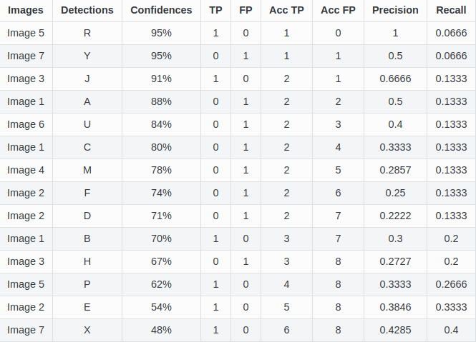
Mean Average Precision (mAP) [1]
Precision and Recall:

Slide 14
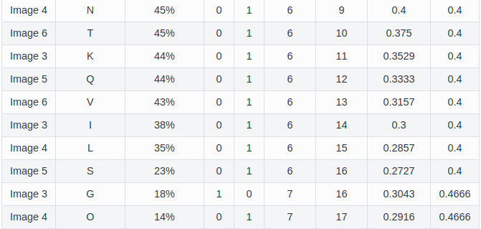
Mean Average Precision (mAP) [1]
Precision and Recall:

Slide 15
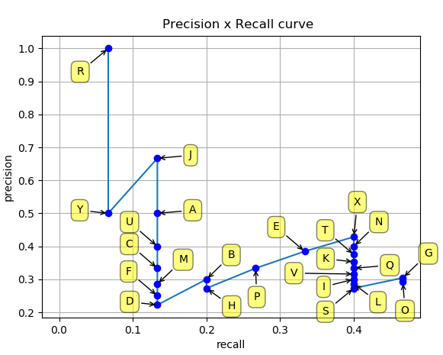
Mean Average Precision (mAP) [1]
Precision vs. Recall Curve

Slide 16
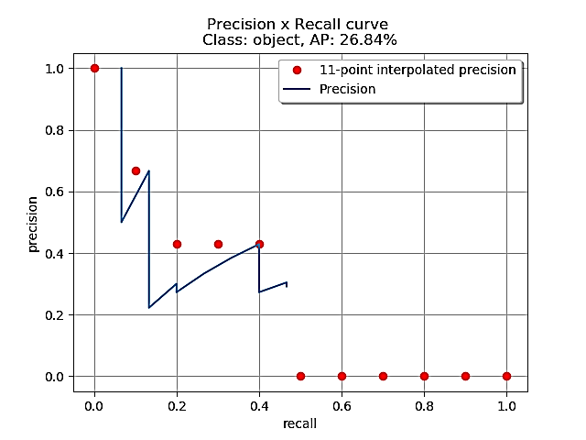
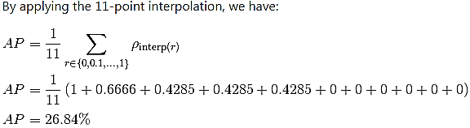
Mean Average Precision (mAP) [1]
Calculating the 11-point interpolation

Slide 17
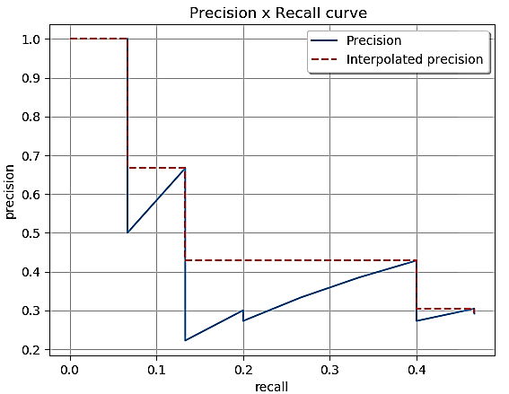
Mean Average Precision (mAP) [1]
Calculating the interpolation performed in all points

Slide 18
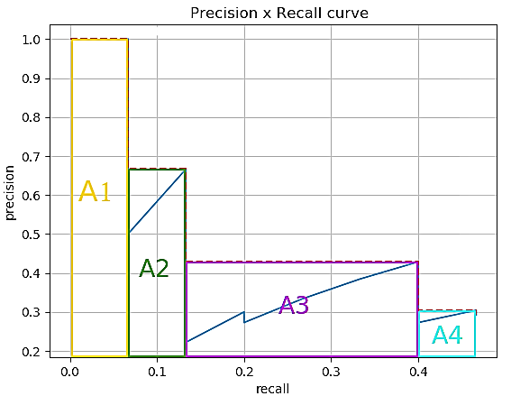
Mean Average Precision (mAP) [1]
Calculating the interpolation performed in all points

Slide 19
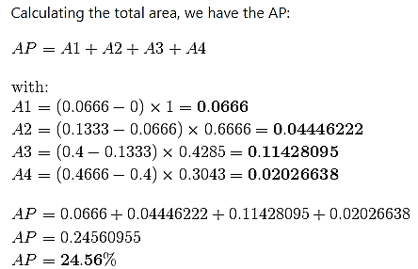
Mean Average Precision (mAP) [1]
Calculating the interpolation performed in all points

Slide 20
Mean Average Precision (mAP) [1]
Putting it all together
Now that we’ve defined Average Precision (AP) and seen how the IoU threshold affects it, the mean Average Precision or mAP score is calculated by taking the mean AP over all classes and/or over all IoU thresholds, depending on the competition. For example:

Slide 21
Mean Average Precision (mAP) [1]
Putting it all together
Now that we’ve defined Average Precision (AP) and seen how the IoU threshold affects it, the mean Average Precision or mAP score is calculated by taking the mean AP over all classes and/or over all IoU thresholds, depending on the competition. For example:
PASCAL VOC2007 challenge only 1 IoU threshold was considered: 0.5 so the mAP was averaged over all 20 object classes.

Slide 22
Mean Average Precision (mAP) [1]
Putting it all together
Now that we’ve defined Average Precision (AP) and seen how the IoU threshold affects it, the mean Average Precision or mAP score is calculated by taking the mean AP over all classes and/or over all IoU thresholds, depending on the competition. For example:
PASCAL VOC2007 challenge only 1 IoU threshold was considered: 0.5 so the mAP was averaged over all 20 object classes.
For the COCO 2017 challenge, the mAP was averaged over all 80 object categories and all 10 IoU thresholds.

Slide 23
Mean Average Precision (mAP) [1]
Putting it all together
Now that we’ve defined Average Precision (AP) and seen how the IoU threshold affects it, the mean Average Precision or mAP score is calculated by taking the mean AP over all classes and/or over all IoU thresholds, depending on the competition. For example:
PASCAL VOC2007 challenge only 1 IoU threshold was considered: 0.5 so the mAP was averaged over all 20 object classes.
For the COCO 2017 challenge, the mAP was averaged over all 80 object categories and all 10 IoU thresholds.
Averaging over the 10 IoU thresholds rather than only considering one generous threshold of IoU ≥ 0.5 tends to reward models that are better at precise localization.

Slide 24
References
https://github.com/rafaelpadilla/Object-Detection-Metrics
https://medium.com/@timothycarlen/understanding-the-map-evaluation-metric-for-object-detection-a07fe6962cf3
Andrew Ng’s slide on object detections

Slide 25
Disclaimer
These slides are not original and have been prepared from various sources for teaching purpose.

